Slide 1
E-Vote – Biometrics Based Secure Online Voting System
Muhammad Zaid Dildar
Saad Mehmood
Muhammad Ahmad
Supervised by: Lecturer Fawad Khan

Slide 2
Agenda
Problem & Motivation
Our Proposed Solution
Architecture Overview
Implementation Details
Testing & Evaluation
SDGs & Future Scope

Slide 3
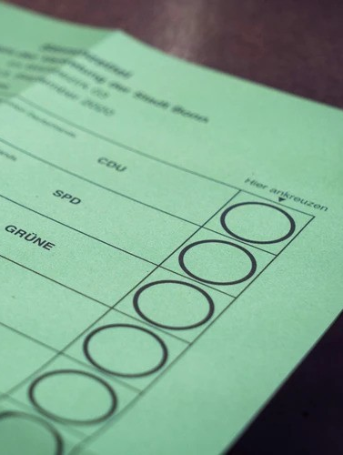
Problem Statement
Time-consuming & error-prone
Paper usage → not eco-friendly
Inaccessible for off-campus students
Hard to audit
Low participation

Slide 4

Motivation
Secure and accessible digital elections
Transparency & trust
Inspired by WebAuthn and real-time dashboards

Slide 5

Our Solution: E-Vote
Biometric login using WebAuthn
Admin, Auditor, Voter modules
Real-time results & monitoring
Built with Next.js, Express.js, MongoDB

Slide 6
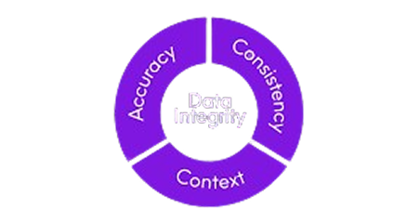
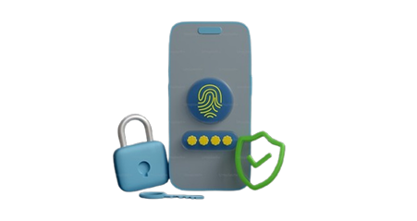


Objectives
Secure & transparent voting
Real-time election analytics
Simplified admin process
Boost student engagement
User Friendly

Slide 7

Scope of the System
Covers full election lifecycle
Role-based access
Integrated analytics & audit logs

Slide 8
Key Modules
Admin – Election & User management
Voter – Cast vote & view results
Auditor – Monitoring only (read-only)

Slide 9






System Architecture
UI/UX Design: Figma
Frontend: Next.js
Backend: Express.js
Database: MongoDB
Deployed on Vercel
Role-based architecture

Slide 10
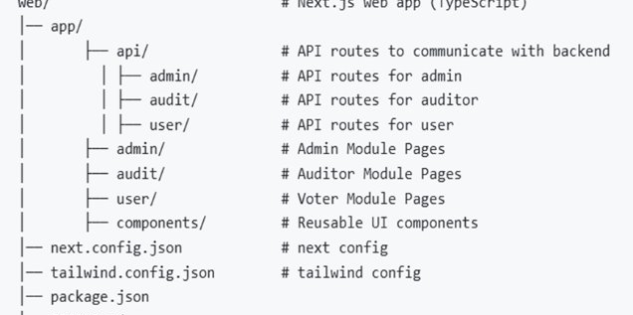
Frontend Structure
Component-based React design
Server-Side Rendering
Dynamic routing
Biometric API Integration

Slide 11
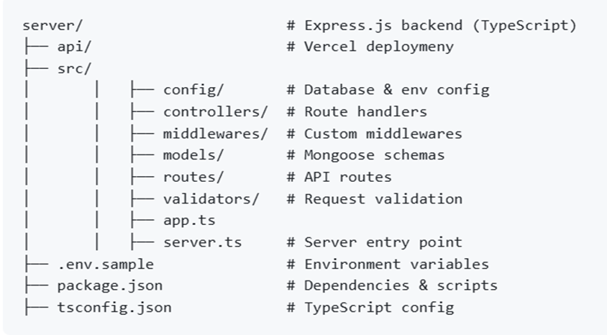
Backend APIs
Models for users, elections and votes
Service functions for users, elections and votes
Controllers for users, elections and votes
JWT-based access control

Slide 12
Database Design
User: with biometric fields
Election: candidates, timing
Votes: secure + timestamped
AuditLogs: trace every action

Slide 13
Biometric Authentication
WebAuthn standard used
Biometric-only login enforced
Prevents PIN-only logins
Public-key cryptography based

Slide 14
Election Management
Admin creates elections
Adds candidates
Sets start/end time
Filters voters by department

Slide 15
Voting Flow
Login
Biometric Verification
View Elections
Cast Vote
Confirmation
Confirmation
Login
Biometric Verification
View Elections
Cast Vote

Slide 16
Auditor Features
Real-time election observation
Cannot modify data
Advanced filtering
Verify results & logs

Slide 17

Security Protocols
HTTPS & JWT auth
XSS, CSRF, SQLi protection
Password hashing & biometric identity
Audit trails encrypted

Slide 18


Testing Methodology
Unit Testing (Jest)
Integration Testing (API+DB)
E2E Testing (Real scenario)
Load Testing: 1000 users simulated

Slide 19
Performance Results
100 users: 320ms
500 users: 680ms
1000 users: 1.2s

Slide 20
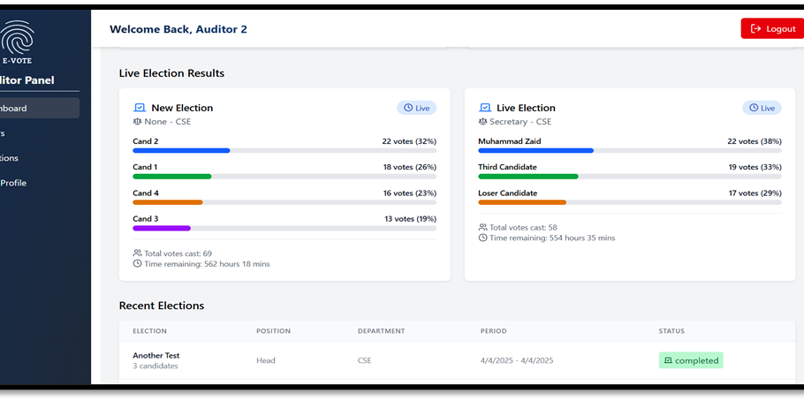
Results Analytics Dashboard
Live turnout per department
Winning candidate graphs
Raw vote breakdown

Slide 21
SDGs Covered
SDG 5: Gender Equality
SDG 9: Industry, Innovation & Infrastructure
SDG 16: Peace, Justice & Strong Institutions

Slide 22
Impact
75% admin time reduced
Better participation
Trusted digital process
Environmentally friendly

Slide 23
Future Work
Mobile App
Blockchain integration
Predictive Analytics
AI-generated reports

Slide 24
Lessons Learned
Balancing security vs usability
User-centered iterative design
Importance of documentation
Incremental rollouts helped refine

Slide 25
Thank You!
Visit: https://e-vote-x.vercel.app
Email: support@mcs.nust.edu.pk
Questions?

